Slide 1
Week 4 : RUBY

Slide 2
What is a programming language ?
What is the difference between HTML and Ruby?

Slide 3

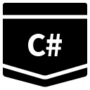








But when it comes to
talk to a Computer … ??!!

Slide 4

A programming language is a formal computer language
designed to communicate instructions to a machine, particularly a computer.
Programming languages can be used to create programs to control the behavior of a machine or to express algorithms.

Slide 5
The most basic (called low-level) computer language is the machine language that uses binary ('1' and '0')

Slide 6
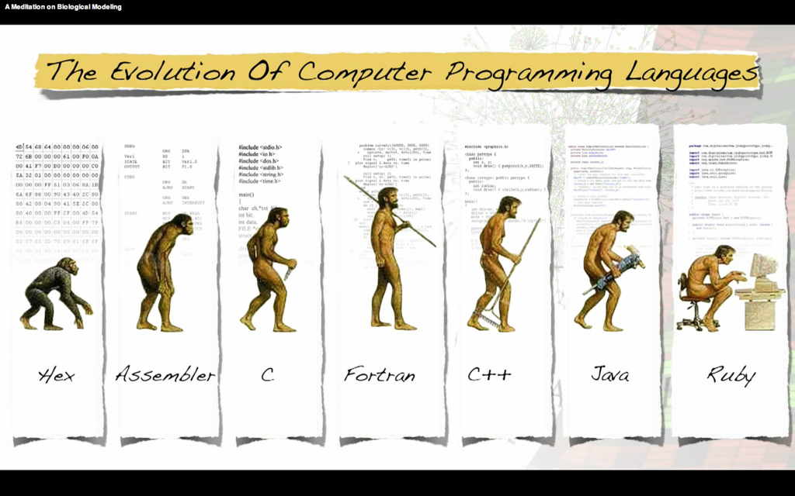

Slide 7
What is a programming language ?
What is the difference between HTML and Ruby?

Slide 8

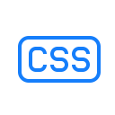



If you were a website, then
Ruby
is your body.
provides your body the attributes like color, height, width etc.
Ruby and Python are like brain, they work in the back-end of what you physically do.

Slide 9
Python and Ruby are programming languages. HTML and CSS are for formatting web pages.
You use Python/Ruby/programming langauges to instruct a computer to perform certain actions on an input, and return an output. You use HTML and CSS to format output (when you want that output to appear on a website).

